Slide 1
Recap from Wednesday
        Shell code -- Done
        Started poking at Lab 1
        xv6, required
        optional textbook
        The website
张义飞 2015

Slide 2
Outline
  x86 Architecture
  The Boot Process
  Protection
  Wrap-Up
张义飞 2015

Slide 3
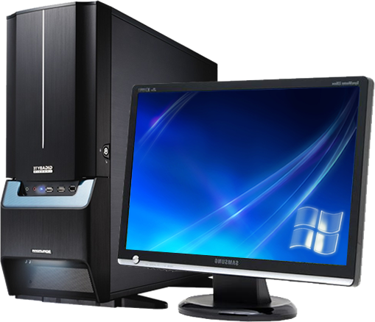
Defining a PC
Outside:
A box
monitor
keyboard
mouse
Other I/O devices
张义飞 2015

Slide 4
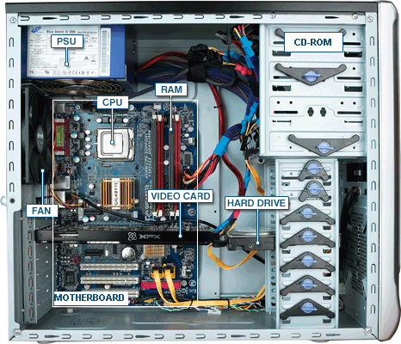
Defining a PC
Inside that box:
CPU
Motherboard
Memory
Disk drives
I/O cards: Network, Video
Power supply
张义飞 2015

Slide 5
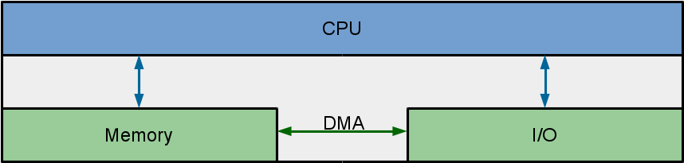
Abstract Model
        I/O: Communicating data to and from devices
        CPU: Logic for performing computation
        Memory: Storage
张义飞 2015

Slide 6
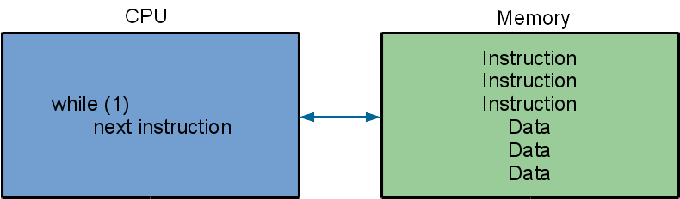
CPU / Memory Interaction
        Memory stores instructions and data
        CPU interprets instructions
张义飞 2015

Slide 7
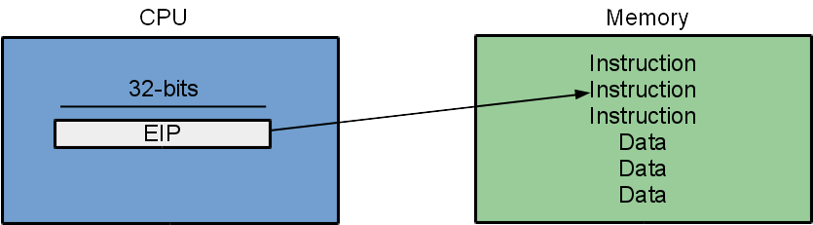
x86 Implementation
        EIP points to next instruction
        Incremented after each instruction
        x86 instructions are not fixed length
        EIP modified by CALL, RET, JMP, and conditional JMP
张义飞 2015

Slide 8
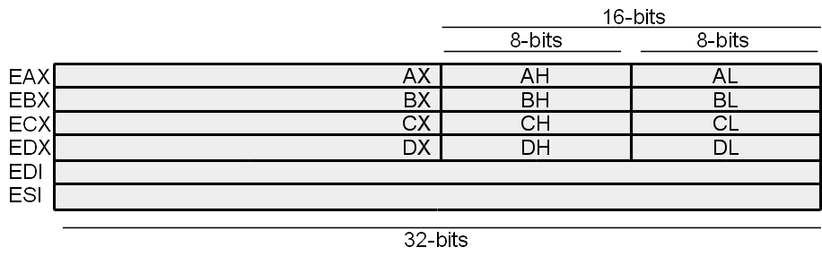
General Purpose Registers (GPR)
Temporary registers
Contents may be changed by instructions
Contents not changed by interrupts / exceptions / traps
EDI/ESI used by string ops but also as GPR
张义飞 2015

Slide 9
Using GPRs
mov $0x10, %eax # eax = 0x10
add $0x10, %eax # eax = 0x20
sub $0x5, %eax # eax = 0x1b
mov $0x2, %ebx
mul %ebx
张义飞 2015

Slide 10
Segmentation Registers
8086 registers 16-bit w/ 20-bit bus addresses
Solution: segment registers:
  CS: code segment, EIP
  SS: stack segment, ESP and EBP
  DS: data segment, register mem ops
  ES: string segment, string ops
Linear address computation:
  EIP => CS:EIP = 0x8000:0x1000 = 0x81000
  ESP => SS:ESP = 0xF800:0x1000 = 0xF9000
  (EAX) => DS:EAX = 0xC123:0x1000 = 0xC2230
张义飞 2015

Slide 11
Even More Segmentation
In protected mode:
  Segment registers point to descriptors
  Descriptors contain offsets, sizes, and permissions
  We'll talk about this a little bit more later
In 32-bit and 64-bit mode, we don't need them.
Why?
Let's disable them! (shown later)
张义飞 2015

Slide 12
x86 Memory Operations
mov $4, %eax # eax = 4
mov $4, (%eax) # phys addr 4 = *4 = 4
mov $8, -4(%eax) # *0 = 8
mov (%eax), %ebx # ebx = 4
mov (%eax), (%ebx) # cannot do memory to memory
mov -4(%eax, %ebx, 1), %ecx # ecx = *(eax - 4 + (ebx * 1)) = *4 = 4
mov $0x10, 4 # *4 = 0x10
张义飞 2015

Slide 13
The Stack
Additional (temporary) storage
Stack registers -- 32-bits long
ESP - stack pointer
EBP - base pointer
张义飞 2015

Slide 14
Using the Stack
_start: # esp = 0xffffdad0
push $0x50 # esp = 0xffffdacc *= 0x50
mov $0x10, %eax
push %eax # esp = 0xffffdac8 *= 0x10
pop %ebx # esp = 0xffffdacc, ebx = 0x10
push $0x422 # esp = 0xffffdac8 *= 0x422
sub $4, %esp # esp = 0xffffdac4 *= ?
mov %eax, (%esp) # esp = 0xffffdac4 *= 0x10
张义飞 2015

Slide 15
Using EBP
Commonly used by functions for backtrace:
push %ebp
mov %esp, %ebp
张义飞 2015

Slide 16
GCC calling convention
example: cprintf(char *fmt, ...)
+------------+
| arg 2 |
+------------+
| arg 1 |
+------------+
| ret %eip |
+------------+
| saved %ebp |
%ebp-> +------------+
| |
| |
| local |
| variables |
| |
| |
%esp-> +------------+
张义飞 2015

Slide 17
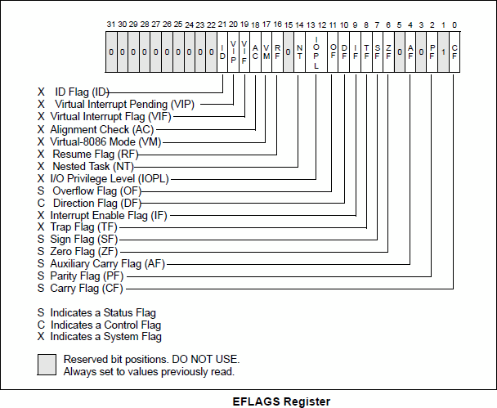
(E)FLAGS Register
Conditional jumps!
张义飞 2015

Slide 18
Using (E)FLAGS Register
mov $5, %ecx
mov $5, %edx
cmp %ecx, %edx # ZF = 1
je equal
...
equal:
...
Lot's of conditional jumps: en.wikibooks.org/wiki/X86_Assembly/Control_Flow
张义飞 2015

Slide 19
What's Remaining?
        I/O interaction
        x86 protected mode
        x86 boot process
        Let's take a look at xv6!
张义飞 2015

Slide 20
Outline
  x86 Architecture
  The Boot Process
  Protection
  Wrap-Up
张义飞 2015

Slide 21
Starting an OS
Computer turns on, BIOS loads
张义飞 2015

Slide 22
What is a BIOS?
The bootstrapper -- finds and initializes hardware
Offers a common interface to hardware
BIOS typically 16-bit
BIOS exists on an EEPROM and not very big
张义飞 2015

Slide 23
Starting an OS
Computer turns on, BIOS loads
  BIOS searches for disks
  Copies boot loader into 0x7c00
  Sets processor EIP to 0x7c00
OS (bootloader) starts executing
Problem: CPU starts executing in real mode:
simulated 8088 / 16-bit
张义飞 2015

Slide 24
Setting up 32-bit Mode
Open xv6/bootasm.S: page 91 of xv6-rev7.pdf
Disable interrupts: cli sets EFLAGS_IF = 0
Create a Global Descriptor Table
Enable protected mode in CRO_PE
Load a new value into segment register
张义飞 2015

Slide 25
Global Descriptor Table
8441 lgdt gdtdesc
8480 # Bootstrap GDT
8481 .p2align 2 # force 4 byte alignment
8482 gdt:
8483 SEG_NULLASM # null seg
8484 SEG_ASM(STA_X|STA_R, 0x0, 0xffffffff) # code seg
8485 SEG_ASM(STA_W, 0x0, 0xffffffff) # data seg
8486
8487 gdtdesc:
8488 .word (gdtdesc − gdt − 1) # sizeof(gdt) − 1
8489 .long gdt # address gdt
张义飞 2015

Slide 26
Enable Protection
8442 movl %cr0, %eax
8443 orl $CR0_PE, %eax
8444 movl %eax, %cr0
张义飞 2015

Slide 27
Load the new segment
1150 ljmpl $(SEG_KCODE<<3), $(start32) # load gdt[1]
1151
1152 .code32
1153 start32:
张义飞 2015

Slide 28
Starting the Kernel
Setup a stack:
8467 movl $start, %esp
Call into C loader:
8468 call bootmain
Load and start the kernel
xv6/bootmain.c or page 92 of xv6-rev7.pdf
张义飞 2015

Slide 29
Load and Start the Kernel
8516 void
8517 bootmain(void)
...
8524 elf = (struct elfhdr*)0x10000; // scratch space
8525
8526 // Read 1st page off disk
8527 readseg((uchar*)elf, 4096, 0);
...
8543 // Call the entry point from the ELF header.
8544 // Does not return!
8545 entry = (void(*)(void))(elf−>entry);
8546 entry();
张义飞 2015

Slide 30
I/O Devices
readseg reads from disk! How?
Reading a sector (512 bytes) from the disk at a time:
8560 readsect(void *dst, uint offset)
...
8563 waitdisk();
8564 outb(0x1F2, 1); // count = 1
8565 outb(0x1F3, offset);
....
8569 outb(0x1F7, 0x20); // cmd 0x20 − read sectors
...
8572 waitdisk();
8573 insl(0x1F0, dst, SECTSIZE/4);
张义飞 2015

Slide 31
outb and insl
Wrappers around assembly:
outb(port, data) - out data, port - out %eax, %ebx
insl is a string wrapper around in
in(port, &data) - in data, port - in %eax, %ebx
张义飞 2015

Slide 32
Memory Mapped I/O
Alternative to using in / out instructions:
Use traditional instructions, like mov, on locations in memory
张义飞 2015

Slide 33
Assembly
We have spoken only about AT&T assembly syntax!
We will only use AT&T syntx in class
Reading / using Intel syntax will not work
张义飞 2015

Slide 34
Example
int main(void)
{
return f(3) + 1;
}
int f(int x)
{
return x + 4;
}
_main:
pushl %ebp # prologue
movl %esp, %ebp
pushl $3 % body
call _f
addl $1, %eax
movl %ebp, %esp
popl %ebp
ret
_f:
pushl %ebp
movl %esp, %ebp
pushl %ebx # don't clobber registers
movl 8(%ebp), %ebx # access argument
addl $4, %ebx
movl %ebx, %eax
popl %ebx # restore
movl %ebp, %esp %epilogue
popl %ebp
ret
张义飞 2015

Slide 35
Outline
x86 Architecture
The Boot Process
Protection
Wrap-Up
张义飞 2015

Slide 36
x86 Protected Mode
We entered to turn on 32-bit mode.
What else might it be useful for?
Process / code separation!
Low privilege level cannot escape to higher privilege
Cannot access other's memory
Cannot change global PC state
Limits instruction calls
What does it look like? How is that enforced?
Lower two bits of CS register
... and a topic for a later lecture ...
张义飞 2015

Slide 37
Observing Protected Mode
4 privilege levels: 0 - 3, highest to lowest
x86 checks privilege level:
        I/O and privileged instructions
        Interrupts / Traps
        Accessing memory
Privilege can be increased for well-defined special cases: system calls
张义飞 2015

Slide 38
But...
Segmentation has flaws, especially with memory holes for MM/IO...
Our first descriptors define flat address at privilege level 0
Later we define a second set for users for a flat address space
Next Lecture: Page Tables, better management of memory
张义飞 2015

Slide 39
But...
Segmentation has flaws, especially with memory holes for MM/IO...
Our first descriptors define flat address at privilege level 0
Later we define a second set for users for a flat address space
Next Lecture: Page Tables, better management of memory
张义飞 2015

Slide 40
Outline
x86 Architecture
The Boot Process
Protection
Wrap-Up
张义飞 2015

Slide 41
UEFI
BIOS issues:
  Old and 16-bits
  Limited support for hard disk sizes (< 2TB)
  Limited to EEPROM -- small in size
UEFI advantages:
  Support for rich pre-boot environment
  Modern support for hard drives
  Secure boot
张义飞 2015

Slide 42
x86 Architecture in Qemu
Qemu is an x86 emulator / virtual machine
Qemu focuses on state not simulation
  We won't be worrying about pipelines, superscalar, etc
Restricted to x86 instructions, CPU state, and memory
张义飞 2015

Slide 43
Testing Assembly Code
In JOS:
Make your own monitor call and use asm volatile instructions
In Linux: ...
张义飞 2015

Slide 44
$ vim test.as
.global _start
.text
_start:
mov $0x10, %eax
mov %eax, %ebx
movl $1, %eax
int $0x80
$ as --386 -o test.o test.as $ ld -m elf_i386 -o test test.o
$ ./test
$ echo $?
16
$
Return value can only be between 0 and 255
张义飞 2015

Slide 45
Next Time
Wednesday 1:00PM
Page Tables and Virtual Memory
张义飞 2015

